Slide 1
Health Outcomes across the US
Exploring Socioeconomic Factors, Lifestyle, and Environmental Conditions behind Early Mortality
Group 1: Eva Anderson, Kelsie Bumadianne,
Heather Eby, and Abigail Husain
Notes:
Heather

Slide 2
Key Factors Influencing Early Mortality
Which are the most impactful factors on early mortality in the U.S.?
How do socioeconomic factors impact early mortality in the U.S. and how strong is the correlation?
How do lifestyle factors impact early mortality in the U.S. and how strong is the correlation?
How does access to health resources impact early mortality in the U.S. and how strong is the correlation?
How do environmental factors impact early mortality in the U.S. and how strong is the correlation?
How do these relationships vary by geographic regions across the U.S.?
Notes:
Heather - Define early mortality and why it is an important factor
Years of Potential Life Lost (YPLL) is a widely used measure of the rate and distribution of premature mortality. Measuring premature mortality, rather than overall mortality, focuses attention on deaths that might have been prevented. YPLL emphasizes deaths of younger persons, whereas statistics that include all mortality are dominated by deaths of the elderly (https://www.countyhealthrankings.org/health-data/health-outcomes/length-of-life/premature-death?year=2024)

Slide 3
Database Overview
County Health Rankings & Roadmaps
County Health Rankings & Roadmaps (CHR&R), a program of the University of Wisconsin Population Health Institute, draws attention to why there are differences in health within and across communities. The 2024 Annual Data Release was used for this analysis
Census API
The American Community Survey (ACS) is an ongoing survey conducted by the U.S. Census Bureau that collects detailed demographic, social, economic, and housing data from a sample of households, providing vital information for policy-making and community planning.
Notes:
Eva

Slide 4
Key Steps of Data Preparation
The bulk of data came from an .xlsx file with additional data coming from census shapefile data and the U.S. Census API.
Data was split into state and county level DataFrames
Data was analyzed for missing data at the state and county level
Shape files were modified for finding the geographic center of each state
Columns were reorganized and renamed
Finalized files were written to the processed data folder
Notes:
Eva

Slide 5
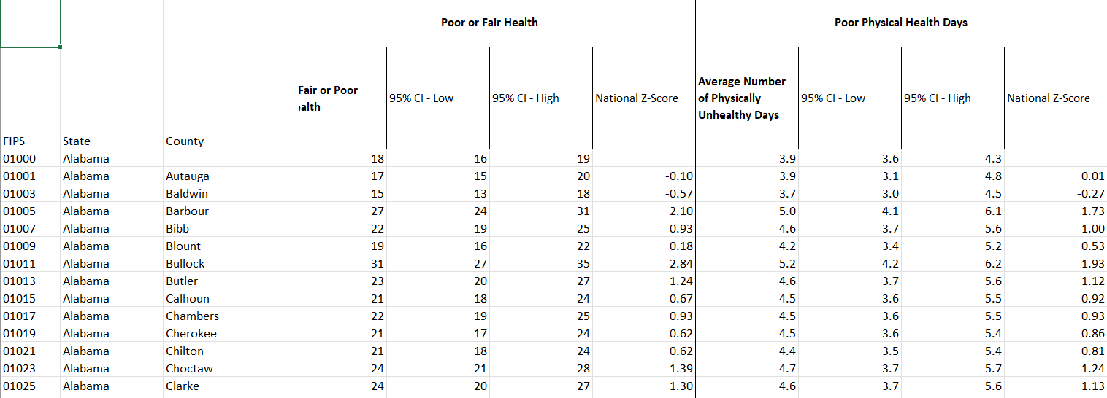
Data Cleaning
How can we turn this into something we can use?
Notes:
Eva

Slide 6
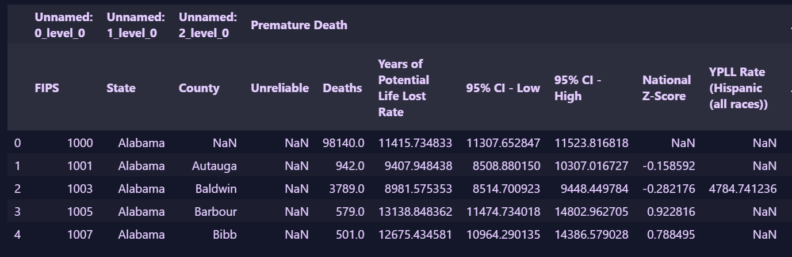
Issue One: Naming Conventions
The .xlsx document had multiple levels of heading.
Notes:
Eva

Slide 7
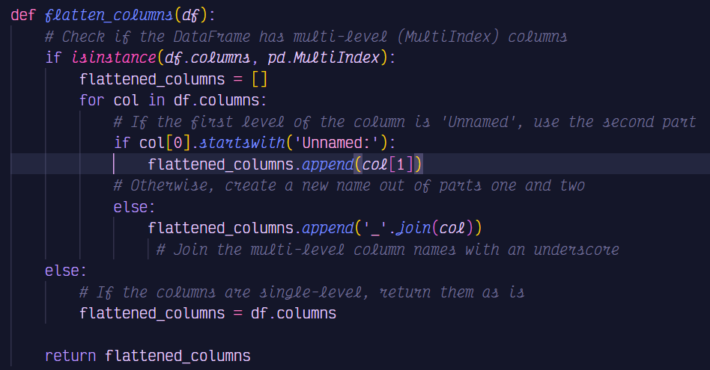
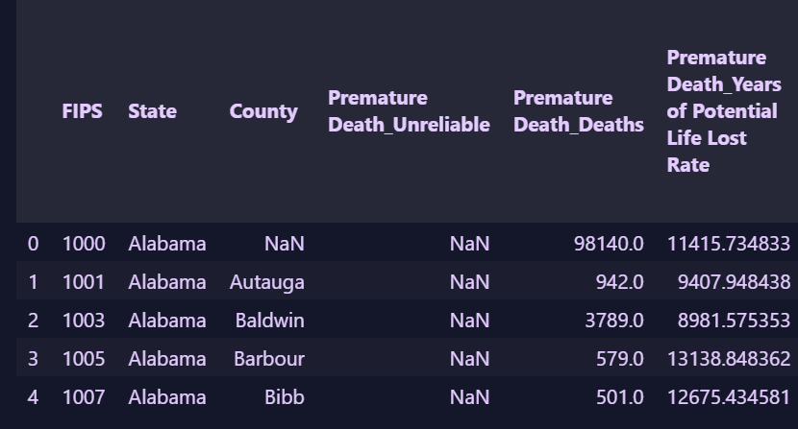
Issue One: Naming Conventions
The function
The results
Notes:
Eva

Slide 8
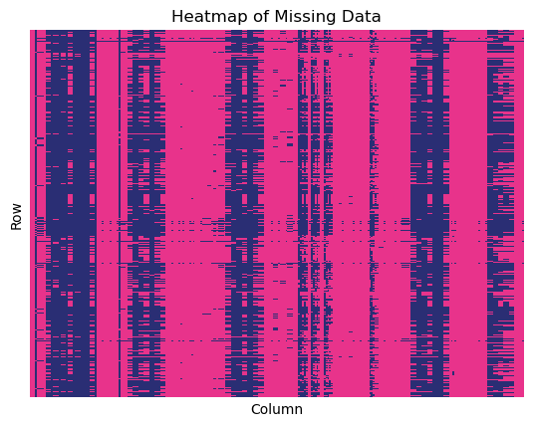
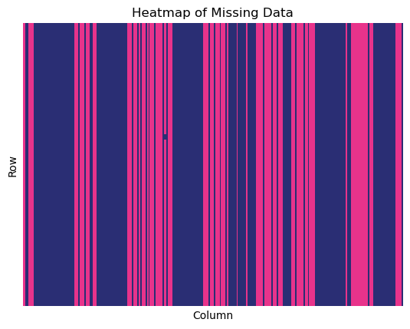
Issue Two: Missing Values
County Level
State Level
Notes:
Eva

Slide 9
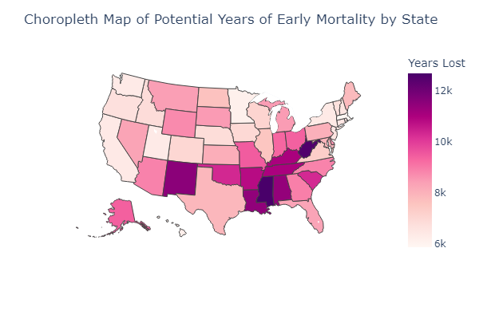
Notes:
Eva

Slide 10
Factors We Explored
Socioeconomic
Lifestyle Factors
Resource Access
Median Household Income
Income Inequality
Unemployment
Housing Overcrowding and Inadequacy
Health Insurance Rate
Adult Obesity
Excess Drinking
Physical Activity Level
Smoking
Poor Mental and Physical Health Days
Food Environment Index
Exercise Access
Primary Care Physician Access
Dental Care Access
Mental Health Care Access
Notes:
Kelsie

Slide 11
Surprisingly Weak Factors:
Excess Drinking and Inadequate Housing
Notes:
Kelsie

Slide 12
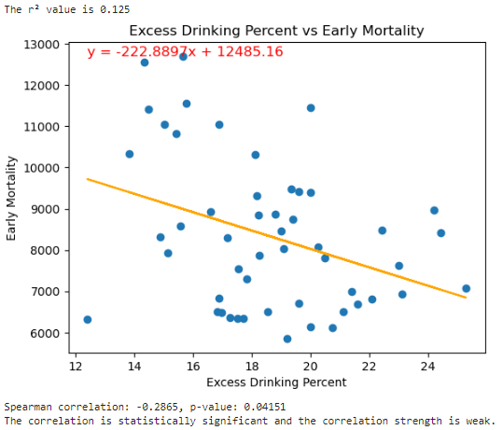
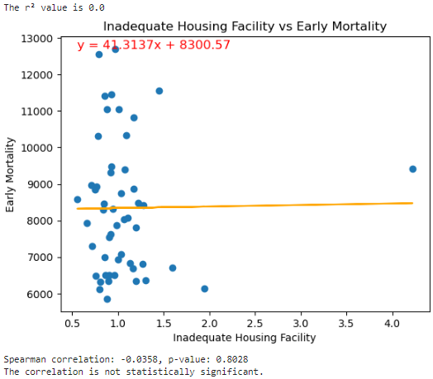
Excess Drinking
Housing Inadequacy
Notes:
Kelsie
Excessive Drinking is the percentage of a adults that reports binge or heavy drinking in the past 30 days. (age-adjusted). Estimates may not be comparable across states because of methodological changes discussed in “The method for calculating Excessive Drinking has changed”
Percentage of households with lack of kitchen or plumbing facilities.
Severe Housing Problems is the percentage of households with one or more of the following housing problems:
housing unit lacks complete kitchen facilities;
housing unit lacks complete plumbing facilities;
household is overcrowded; or
household is severely cost burdened.

Slide 13
Moderate Factors:
Poor Physical Health Days, Exercise Access, and Primary Care Physician Rate
Notes:
Kelsie

Slide 14
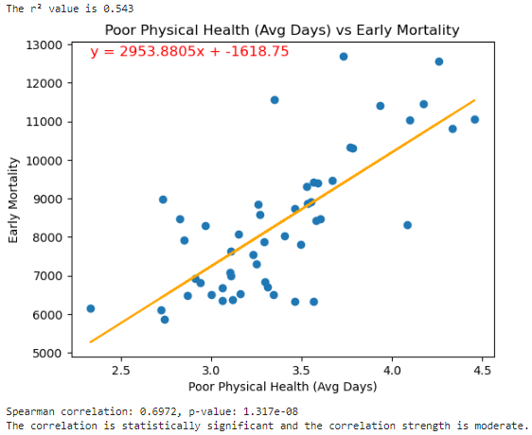
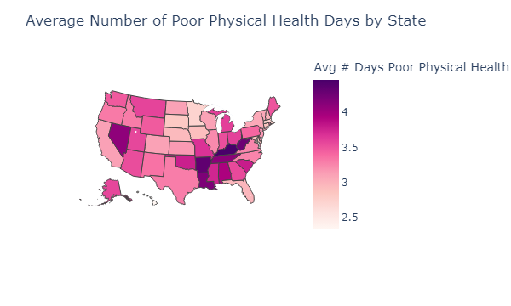
Poor Physical Health Days
Notes:
Kelsie - Average # of physically unhealthy days reported in past 30 days (age-adjusted).

Slide 15
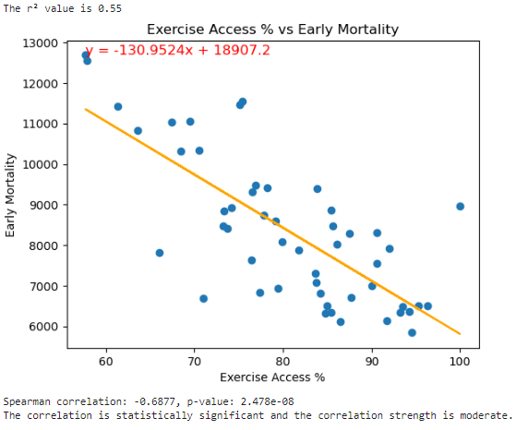
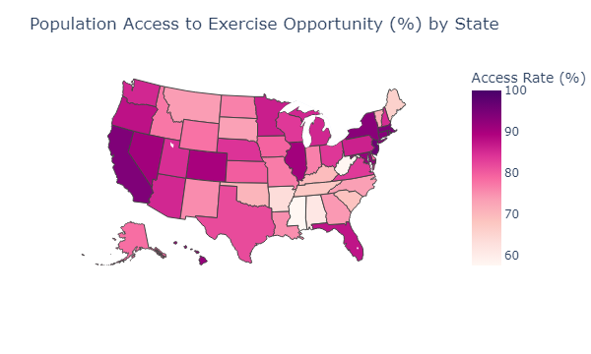
Exercise Access Percent
Notes:
Kelsie - Percentage of population with adequate access to locations for physical activity.
Access to Exercise Opportunities measures the percentage of individuals in a county who live reasonably close to a location for physical activity. Locations for physical activity are defined as parks or recreational facilities. Individuals are considered to have adequate access to exercise opportunities if they:
• reside in a census block that is within a half mile of a park, or
• reside in a census block that is within one mile of a recreational facility in an urban area, or
• reside in a census block that is within three miles of a recreational facility in a rural area.

Slide 16
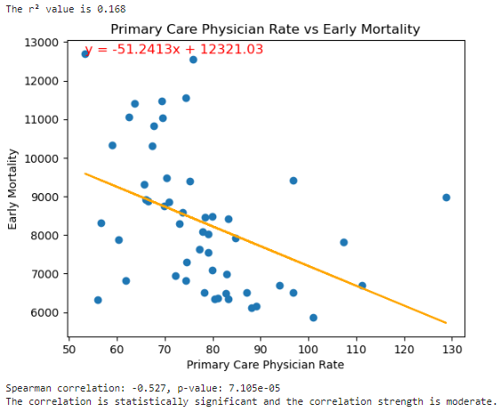
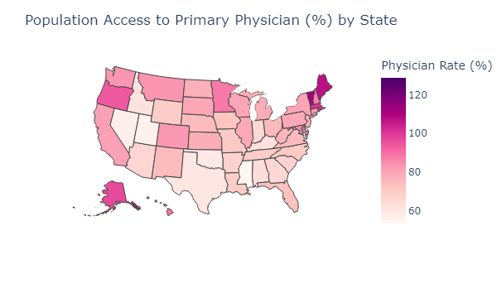
Primary Care Physician Rate
Notes:
Kelsie - Primary Care Physicians per 100,000 population

Slide 17
Strong Factors:
Food Environment Index, Adult Obesity Rate, and Median Household Income
Notes:
Abi

Slide 18
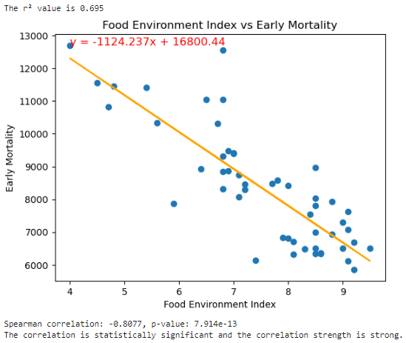
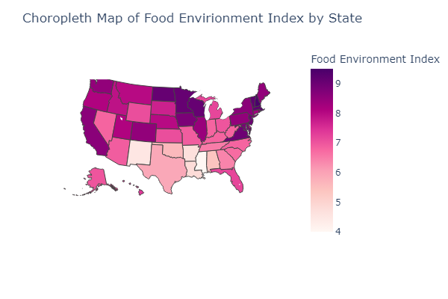
Food Environment Index
Notes:
Abi - Index of factors that contribute to a healthy food environment, from 0 (worst) to 10 (best). The 2024 Annual Data Release used data from 2019 & 2021 for this measure. The Food Environment Index accounts for both proximity to healthy foods and income. This measure includes access to healthy foods by considering the distance an individual lives from a grocery store or supermarket, locations for health food purchases in most communities, and the inability to access healthy food be

Slide 19
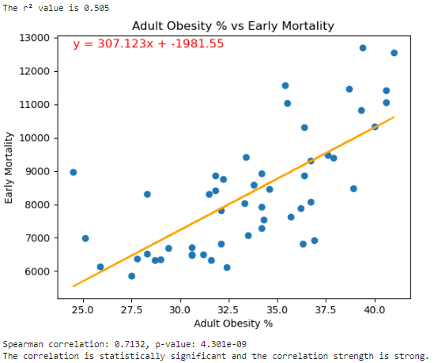
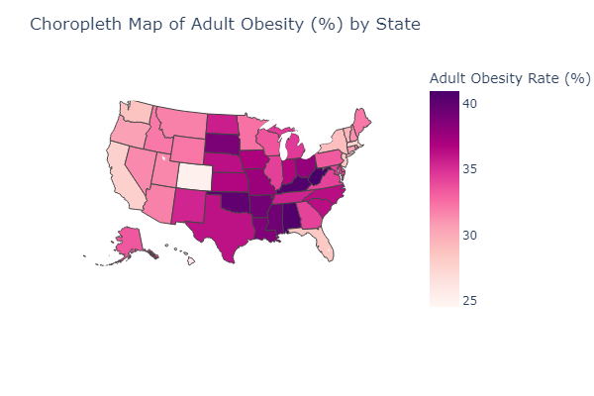
Adult Obesity Percent
Notes:
Abi - Percentage of the adult population (age 18 and older) that reports a body mass index (BMI) greater than or equal to 30 kg/m2 (age-adjusted). The 2024 Annual Data Release used data from 2021 for this measure. Adult Obesity is based on responses to Behavioral Risk Factor Surveillance System (BRFSS) surveys and is the percentage of the adult population (ages 18 and older) that reports a body mass index (BMI) greater than or equal to 30 kg/m2. Participants are asked to self-report their height and weight; BMIs are calculated from these reported values

Slide 20
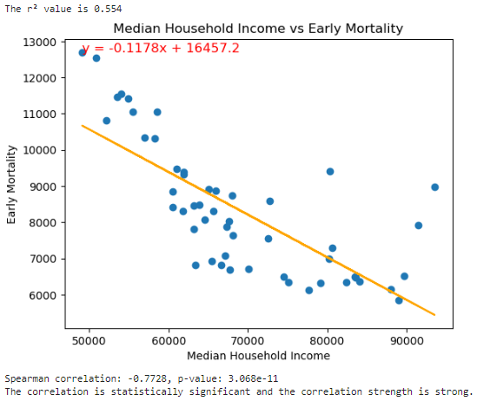
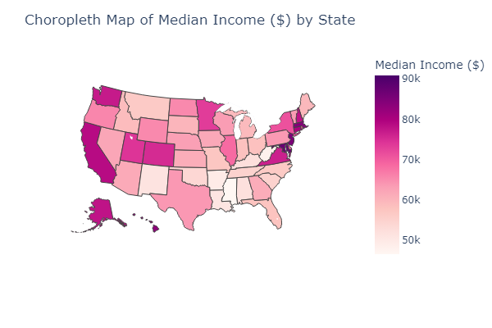
Median Household Income
Notes:
Abi -

Slide 21
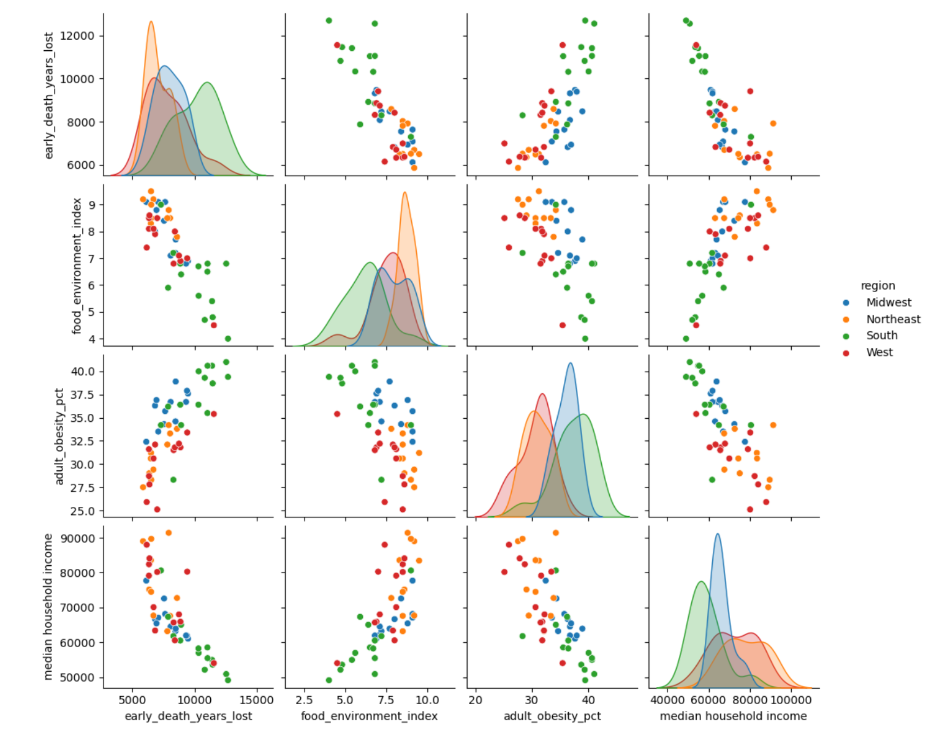
Regional Trends
Notes:
Abi -

Slide 22




States with Lowest Early Mortality Rates
Massachusetts
Massachusetts has near-universal healthcare coverage due to its early adoption of a Health Care Reform Law which requires most adults to have health insurance coverage.
Minnesota
Every year from 2000 to 2022, Minnesota had the lowest overall heart disease death rate in the US. Residents have had lower rates of smoking and high blood pressure.
Hawaii
Hawaii has one of the lowest obesity rates in the US. Their culture encourages community (ohana) and their government takes in active role in providing resources to promote healthy habits for natives.
Utah
Utah has the lowest percentage of US adults who smoke, and has very low rates of substance usage. Lifestyle habits such as exercise are also strong compared to other states.
Notes:
Heather
Massachusetts Image: https://www.travelandleisure.com/travel-guide/boston
Massachusetts Fact: https://www.mahealthconnector.org/about/policy-center/rules-regulations/massachusetts-individual-mandate
Minnesota Image: https://www.cntraveler.com/story/what-to-do-in-minneapolis
Minnesota Fact: https://www.health.state.mn.us/diseases/cardiovascular/data/heartdisease.html#:~:text=In%202023%2C%204%25%20of%20adults,in%20the%20state%20behind%20cancer
https://www.reuters.com/article/business/healthcare-pharmaceuticals/minnesotans-are-kinder-to-their-hearts-study-idUSTRE71975R/
Hawaii Image: https://www.gohawaii.com/trip-planning
Hawaii Fact: https://www.oha.org/our-focus/ and https://www.tfah.org/report-details/state-of-obesity-2023/#:~:text=West%20Virginia%20(41%25)%2C%20Louisiana,the%20lowest%20adult%20obesity%20rates.
Utah Image: https://www.travelandleisure.com/trip-ideas/best-places-to-visit-in-utah
Utah Fact: https://www.forbes.com/advisor/life-insurance/states-ranked-least-healthy-populations/

Slide 23



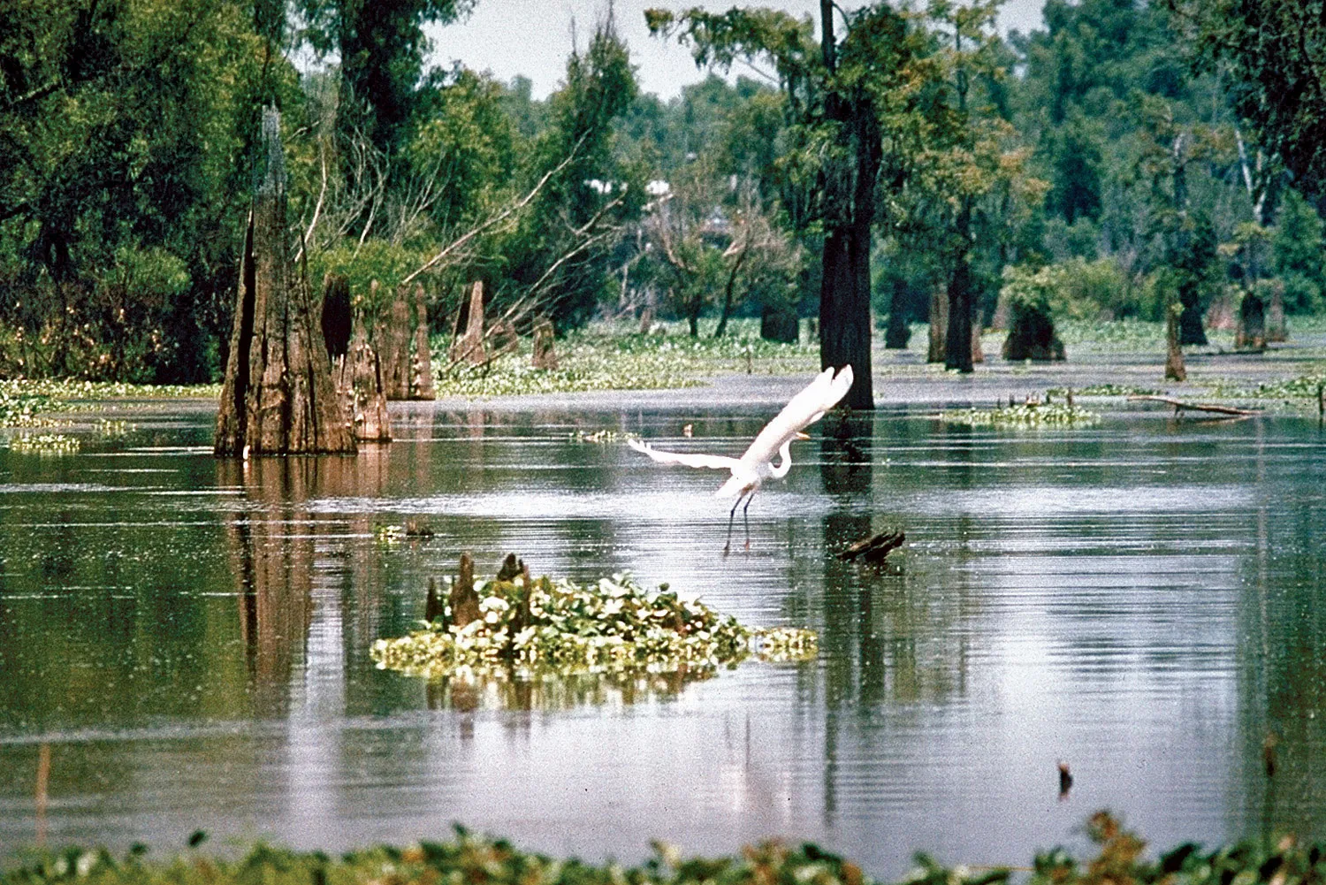
States with Highest Early Mortality Rates
Mississippi
Mississippi has the highest percentage of adults diagnosed with diabetes in the US, which can lead to serious health complications.
West Virginia
West Virginia ranks among the worst in the US in lifestyle habits with the highest obesity rate (41%) and the highest rate of smokers (21%).
New Mexico
Injury is a serious public health problem in New Mexico. Unintentional injuries, which include chiefly unintentional poisoning, firearm injuries, transportation injuries, and falls, were the leading cause of death among children and adults age 1 through 44
Louisiana
Louisiana suffers from one of the highest poverty rates in the US, with 18.6% of the population in poverty in 2022. This has strong implications on access to health resources.
Notes:
Heather
Mississippi Image: https://www.architecturaldigest.com/story/why-i-moved-to-jackson-mississippi
Mississippi Fact: https://www.forbes.com/advisor/life-insurance/states-ranked-least-healthy-populations/
West Virginia Image: https://www.britannica.com/place/West-Virginia
West Virginia Fact: Forbes article
New Mexico Image: https://blog.goodsam.com/10-reasons-to-visit-new-mexico/
New Mexico Fact: https://ibis.doh.nm.gov/topic/healthstatus/InjuryViolence.html
Louisiana Image: https://www.britannica.com/place/Louisiana-state
Louisiana Fact: https://www.labudget.org/wp-content/uploads/2023/11/Census-2022-2023.pdf

Slide 24
Conclusion
Findings
There are many factors that influence early mortality across the U.S. Our analysis found that the factors with the highest correlation are:
Median Household Income
Adult Obesity Rate
Food Environment Index
These factors highlight the impact that wealth, food access, and obesity have on longevity.
Limitations
While premature death is a meaningful way to capture health trends across states, we acknowledge that:
This measure can fail to capture the burden of chronic disease if the age limit is set too low
The effects of state wide intervention may not be reflected in the data for years
Premature death is a relatively rare event, especially in small populations
Notes:
Heather
Source: https://www.countyhealthrankings.org/health-data/health-outcomes/length-of-life/premature-death?year=2024

Slide 25
References
University of Wisconsin Population Health Institute, County Health Rankings (2024)
https://www.countyhealthrankings.org/
Census Microdata API
https://www.census.gov/data/developers/data-sets/census-microdata-api.html
Notes:
Heather
Source: https://www.countyhealthrankings.org/health-data/health-outcomes/length-of-life/premature-death?year=2024

Slide 26
References Cont.
State Facts:
Massachusetts Health Connector:
https://www.mahealthconnector.org/about/policy-center/rules-regulations/massachusetts-individual-mandate
Minnesota Department of Heath: https://www.health.state.mn.us/diseases/cardiovascular/data/heartdisease.html#:~:text=In%202023%2C%204%25%20of%20adults,in%20the%20state%20behind%20cancer
Minnesota Reuters Article: https://www.reuters.com/article/business/healthcare-pharmaceuticals/minnesotans-are-kinder-to-their-hearts-study-idUSTRE71975R/
Office of Hawaiian Affairs:
https://www.oha.org/our-focus/
Trust for Americans Heath: https://www.tfah.org/report-details/state-of-obesity-2023/#:~:text=West%20Virginia%20(41%25)%2C%20Louisiana,the%20lowest%20adult%20obesity%20rates
Forbes Advisor:
https://www.forbes.com/advisor/life-insurance/states-ranked-least-healthy-populations/
New Mexico’s Health Indicator Data:
https://ibis.doh.nm.gov/topic/healthstatus/InjuryViolence.html
Louisiana Budget Project Census Data:
https://www.labudget.org/wp-content/uploads/2023/11/Census-2022-2023.pdf

Slide 27
References Cont.
State Images:
Massachusetts:
https://www.travelandleisure.com/travel-guide/boston
Minnesota:
https://www.cntraveler.com/story/what-to-do-in-minneapolis
Hawaii:
https://www.gohawaii.com/trip-planning
Utah:
https://www.travelandleisure.com/trip-ideas/best-places-to-visit-in-utah
Mississippi:
https://www.architecturaldigest.com/story/why-i-moved-to-jackson-mississippi
West Virginia:
https://www.britannica.com/place/West-Virginia
New Mexico:
https://blog.goodsam.com/10-reasons-to-visit-new-mexico/
Louisiana:
https://www.britannica.com/place/Louisiana-state

